Slide 1
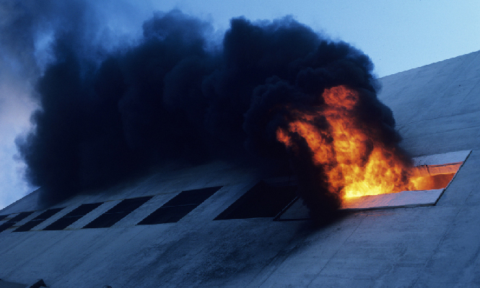

Detection of Fire from Images
Using Deep Learning
Supervised By:
Ms. Arifa Sultana
Lecturer
School of Science, Engineering and Technology
East Delta University
Presented By:
Jahidul Hasan
182001222E
Tithi Saha
191000822E
Shatu Moni Dey
191001622E

Slide 2
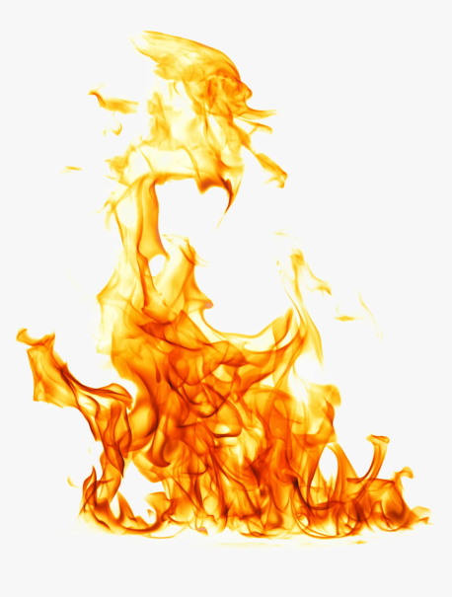
Contents
Introduction
Methodology
Objectives
Result Analysis
Motivation
Conclusion
Related Works
Future Work
2

Slide 3
C
Introduction
In 2015, 1193 persons were injured and 17,700 were killed in India.[1]
Australian wildfire of 2019-2020 were the deadliest forest fires. Half a billion animals killed, 20 million acres burnt, 100 billion dollars damages.[2]
Need to develop fire detection systems to overcome the limitations of the existing
systems.
In this work, we have proposed a deep learning model to identify fire in images.
3

Slide 4
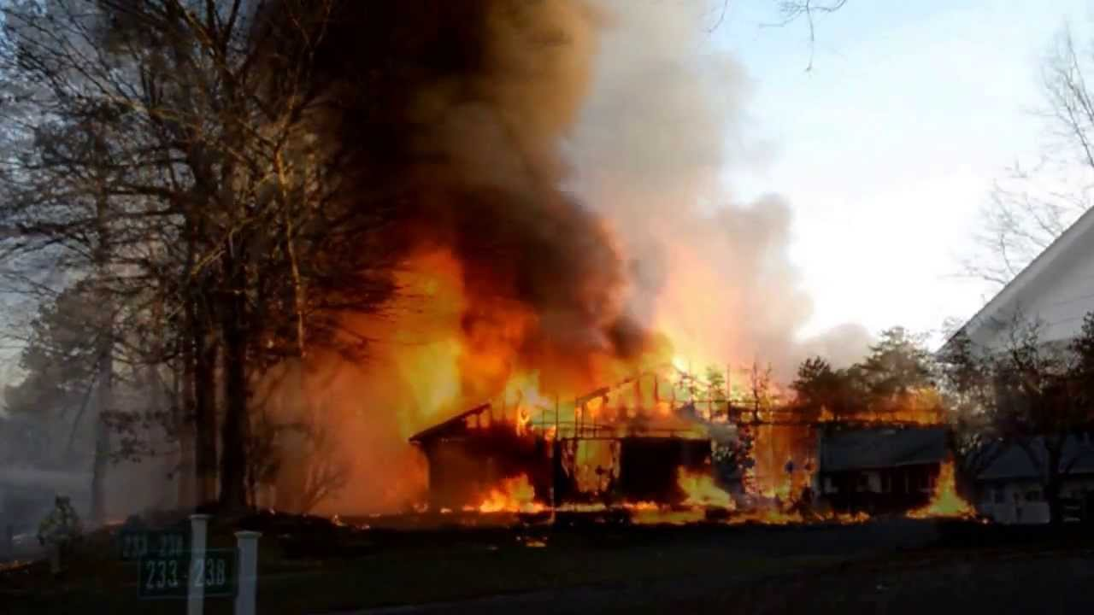

Objectives
Fire detection is a system that detects the presence of fire in an image.
Our objective is:
To develop a model to detect fire from the image during the initial stage.
Assist in fire control activities.
4

Slide 5
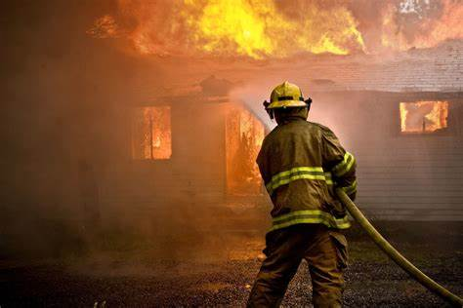
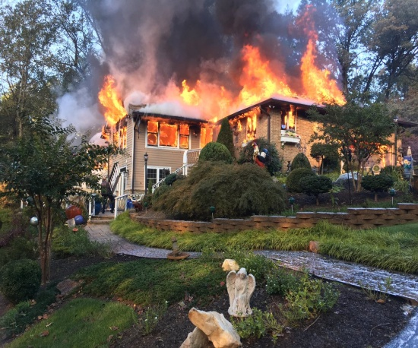
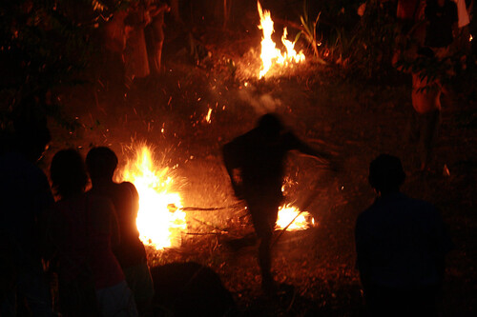

Motivations
Take fast Action
Reduce loss of property
Save Life
5

Slide 6
Related Work
Reference Number | Methodology | Limitations
[3] | Deep normalization and convolutional neural network (DNCNN) used for improve the performance of smoke detection. | Dataset was imbalanced and insufficient.
[4] | Yolo V3 used for fire detection in an image. | The accuracy of the model is 83.7% .
[6] | Convolutional Neural Network is used to identify fire. | The accuracy of the model is 92%.
6

Slide 7
Methodology
Input Image
Image Preprocessing
Feature
Extraction using proposed CNN model
Classification with Sigmoid classifier
Predicted fire/ normal image
7

Slide 8
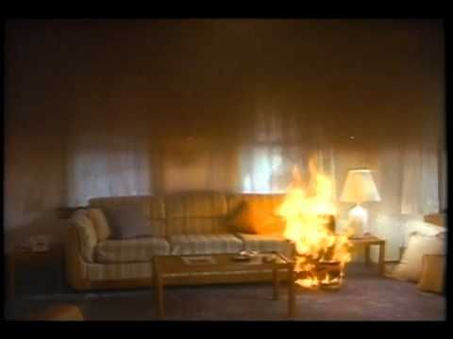
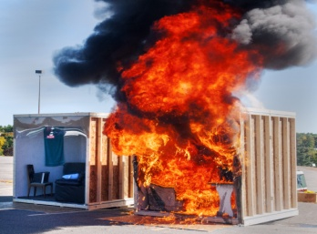
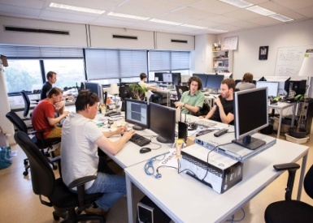


Methodology(Cont.)
Source - kaggle.com, github.com.
Total number of images - 1000
Number of images used - 1000
Images of class “Fire” - 500
Images of class “Normal” - 500
Training data- 80%
Test data- 20%
yawn_eye_data
Figure 1: Sample images from the dataset
8

Slide 9
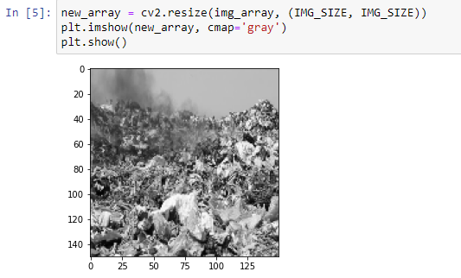
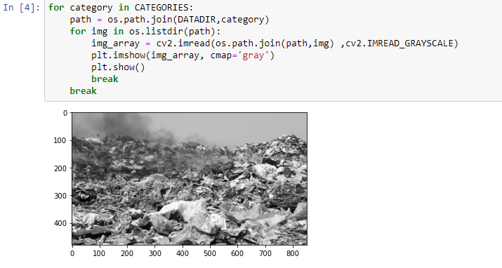
Methodology(Cont.)
Image Preprocessing
- Resize: Set image size to 150 x 150
Color conversion: RGB to BGR (grayscale)
Figure 2: Resized image
Figure 3: RGB to BGR (grayscale)
9

Slide 10
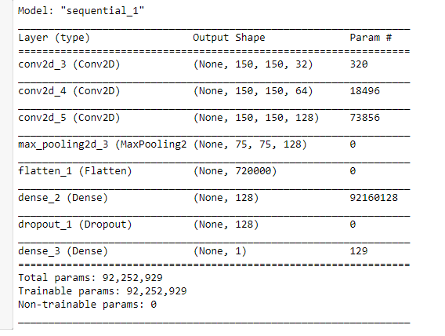

Methodology(Cont.)
Input
3x3 conv + ReLU, 32
3x3 conv + ReLU, 64
3x3 conv + ReLU, 128
2x2 Max-Pool
Flattening
Figure 4: Summary of proposed CNN model
10

Slide 11
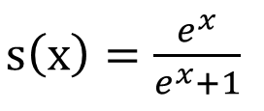
Methodology(Cont.)
The sigmoid function:
Classification with Sigmoid
- The sigmoid function is used for the two-class (binary) classification.
- Sigmoid just makes output between 0 to 1.
11

Slide 12







Methodology(Cont.)
Tools Used
Platform - Jupyter
Programming language - Python
Libraries - OpenCV, Tensorflow, Numpy, Matplotlib, etc.
API – Keras
Used Hyperparameter
Optimizer – Adam
Loss Function- Binary Crossentropy
Learning Rate- 0.001
12

Slide 13
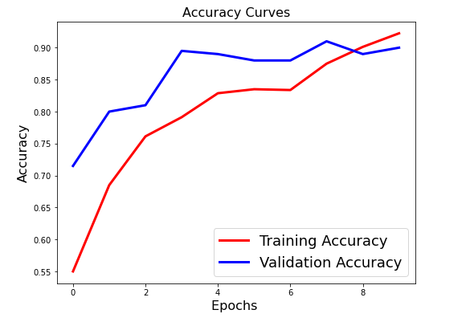
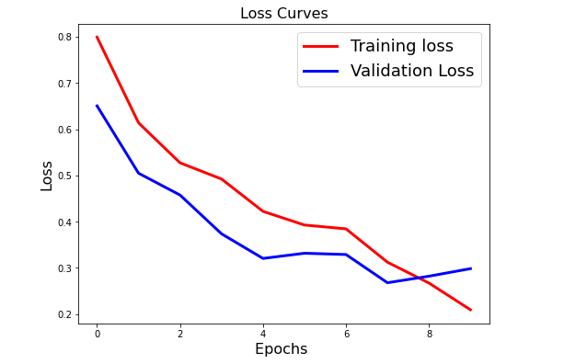

Result Analysis
Figure 5: Visualization of accuracy and loss curve of proposed model.
13

Slide 14
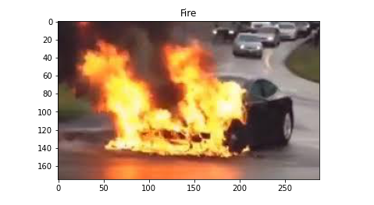
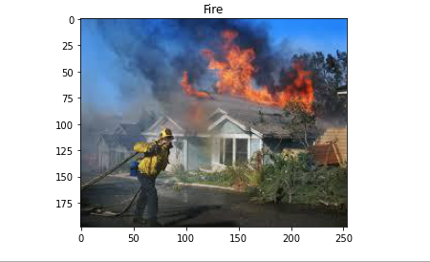
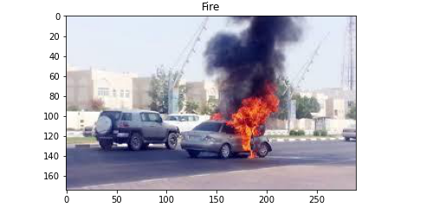
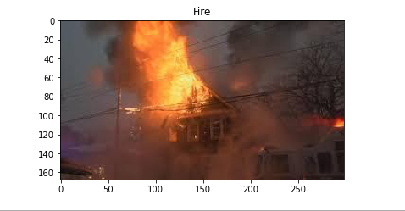
Result Analysis(Cont.)
Figure 6: Correctly Classified Fire Images of our proposed model.
14

Slide 15
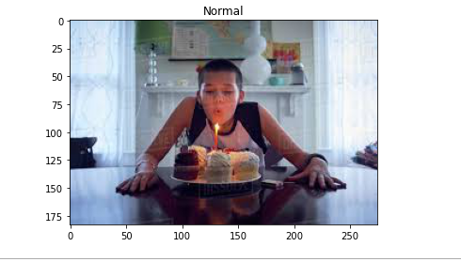
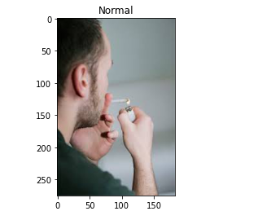
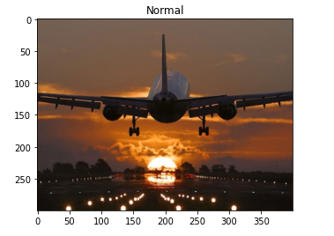
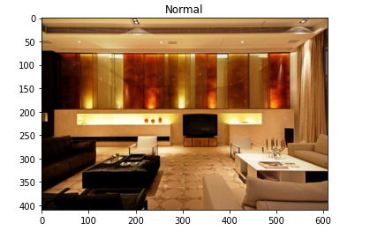
Result Analysis(Cont.)
Figure 7: Correctly Classified Normal images of our proposed model.
15

Slide 16
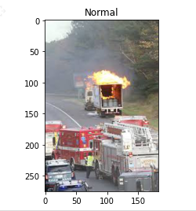
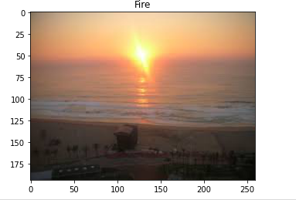
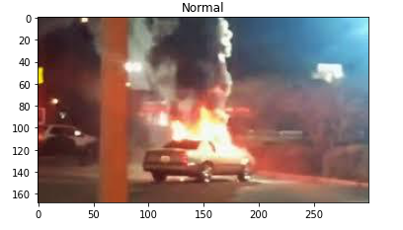
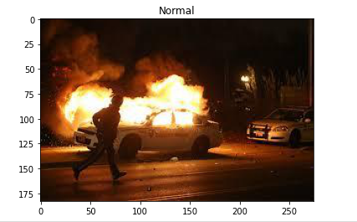
Result Analysis(Cont.)
Figure 8: Misclassified Images of our proposed model.
16

Slide 17
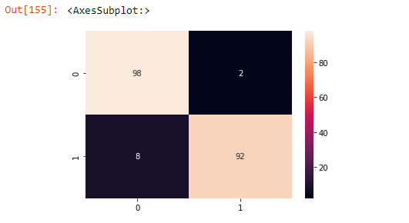
Result Analysis(Cont.)
Figure 10: Confusion Matrix
Table 1: Evaluation of performance matrices
Precision(%) | Recall(%) | F1-Score(%)
92.45 | 98 | 94.91
17

Slide 18
Comparison
Table 2: Performance Comparison of existing works
Research Work | Used Model | Accuracy (%)
[4] | Yolo V3 | 83.7%
[6] | CNN | 92%
Our Proposed Model |  | 98%
18

Slide 19
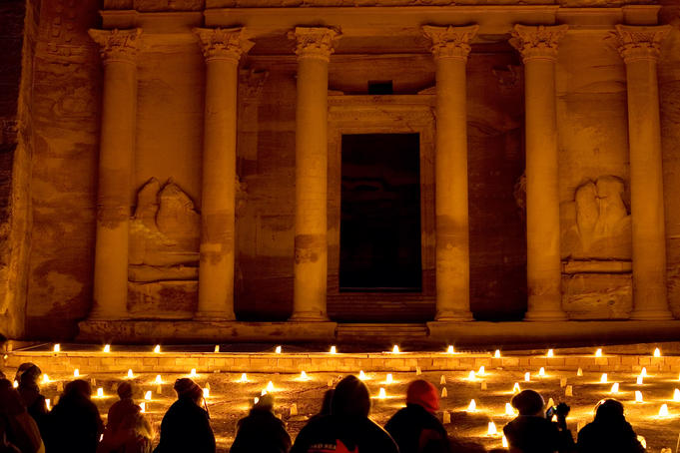
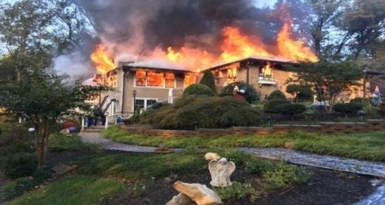
Conclusion & Future Works
An effective Classification Fire detection system is proposed using
convolutional neural network (CNN) and achieved accuracy 98%.
In future, we will work with more deep learning model for better result..
We will try to implement multiclass CNN architecture.
We will also try to detect devastating fire and natural fire related activities.
Figure 11: Fire detected. But its not
harmful.
Figure 12: Fire detected. It’s harmful.
19

Slide 20
Reference
[1] National Building Code 2016 NBC | Insights on Fire Safety | Download (consultivo.in)
[2] Australia's wildfires released as much smoke as a massive volcanic eruption, study finds - CNN
[3] Z. Yin, B. Wan, F. Yuan, et al., “A deep normalization and convolutional neural network for image smoke detection”, IEEE ACCESS, vol. 5, pp.18429–18438, 2017.
[4] Pu Li a,b,* , Wangda Zhao a School of Civil Engineering, “Image fire detection algorithms based on convolutional neural networks”, 2020.
[5] Andrew J. Dunnings1 , Toby P. Breckon1,2, “EXPERIMENTALLY DEFINED CONVOLUTIONAL NEURAL NETWORK ARCHITECTURE VARIANTS FOR NON-TEMPORAL REAL-TIME FIRE DETECTION”, IEEE, 2018.
[6] Raam Pujangga Sadewa , Budhi Irawan, Casi Setianingsih School of Electrical Engineering Telkom University Bandung, “Fire Detection Using Image Processing Techniques with Convolutional Neural Networks”,(ISRITI) 2019
[7] D. Zhang et al., "Image Based Forest Fire Detection Using Dynamic Characteristics with Artificial Neural Networks”, International Joint Conference on Artificial Intelligence, pp. 290-293, 2009.
[8] Fofana, T. , Ouattara, S. and Clement, A., “Optimal Flame Detection of Fires in Videos Based on Deep Learning and the Use of Various Optimizers”, Vol.11 No.11, November 2021
[9] F. Li, L. Tran, K. H. Thung, S. Ji, D. Shen and J. Li, "A robust deep model for improved classification of AD/MCI patients", IEEE J. Biomed. Health Inform., vol. 19, no. 5, pp. 1610-1616, Sep. 2015.
20

Slide 21

21

Slide 22

22

